Slide 1
Dark Web Crawler & Threat Intelligence Dashboard
Cyber Landscape Overview
This project presents a comprehensive solution to monitor and analyze threats emerging from the dark web. The dark background with neon accents reflects the cyber environment, emphasizing the urgency and importance of cybersecurity in today’s digital landscape.

Slide 2
Project Team
Meet the Team
Parvez Shaik – Team Manager & Cybersecurity Expert: Leads the team and ensures the security and compliance of the solution.
Tejas – Lead Developer: Responsible for the system’s architecture and backend development.
shiva – Frontend Engineer: Designs and implements the user interface and dashboard visuals.
Sudheep – Data Analyst: Interprets crawled data and contributes to threat pattern analysis.

Slide 3
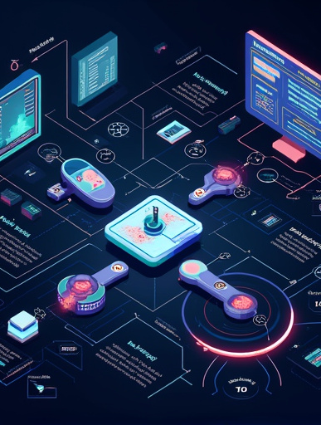
Introduction and Problem Statement
Key Issues in Cybersecurity: The dark web poses significant challenges to cybersecurity, including:
Increased Cyber Threats: The proliferation of illegal activities such as hacking, drug trafficking, and data breaches.
Anonymity of Threat Actors: Difficulty in tracing malicious actors due to the use of anonymizing technologies.
Need for Effective Monitoring: Organizations require robust solutions to detect and respond to threats originating from the dark web.
Call for Solutions: To combat these challenges, there is an urgent need for effective monitoring and intelligence gathering solutions that can provide timely insights into dark web activities.

Slide 4
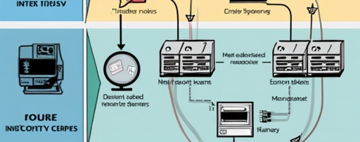
Understanding the Dark Web and Tor
Structure of the Dark Web
Role of Tor
The dark web is a part of the internet that is not indexed by traditional search engines. It requires specific software, configurations, or authorization to access.
Tor (The Onion Router) enables anonymous communication by routing internet traffic through a series of volunteer-operated servers. Visuals depicting connections and traffic patterns help illustrate how users navigate the dark web while maintaining anonymity.

Slide 5
Proposed Solution and Architecture
Proposed Solution
High-Level Architecture
Key Benefits
The proposed solution consists of a dark web crawler that collects data and a threat intelligence dashboard that analyzes and visualizes this data.
The architecture includes the dark web crawler, data processing engine, threat intelligence database, and user interface. It also features a visual representation of how data is collected, processed, and displayed in the dashboard.
This architecture supports real-time data collection, threat analysis, and user-friendly interaction, ensuring timely responses to emerging threats.

Slide 6
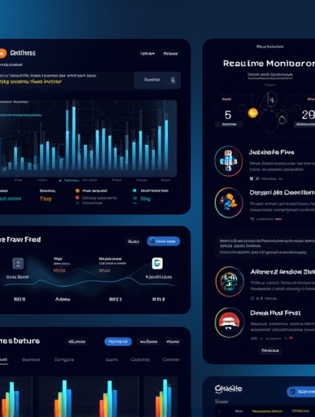
Key Features of the System
Essential Features:
Real-Time Monitoring: Continuous tracking of dark web activities for immediate threat detection.
Threat Alerts: Automated notifications for significant threats or anomalies detected.
Data Visualization: Intuitive visual representations of threat data for easier comprehension.
User-Friendly Interface: Simplified navigation and interaction for users.
Visual Elements: Icons and minimal text will highlight each feature, ensuring clarity and engagement.

Slide 7
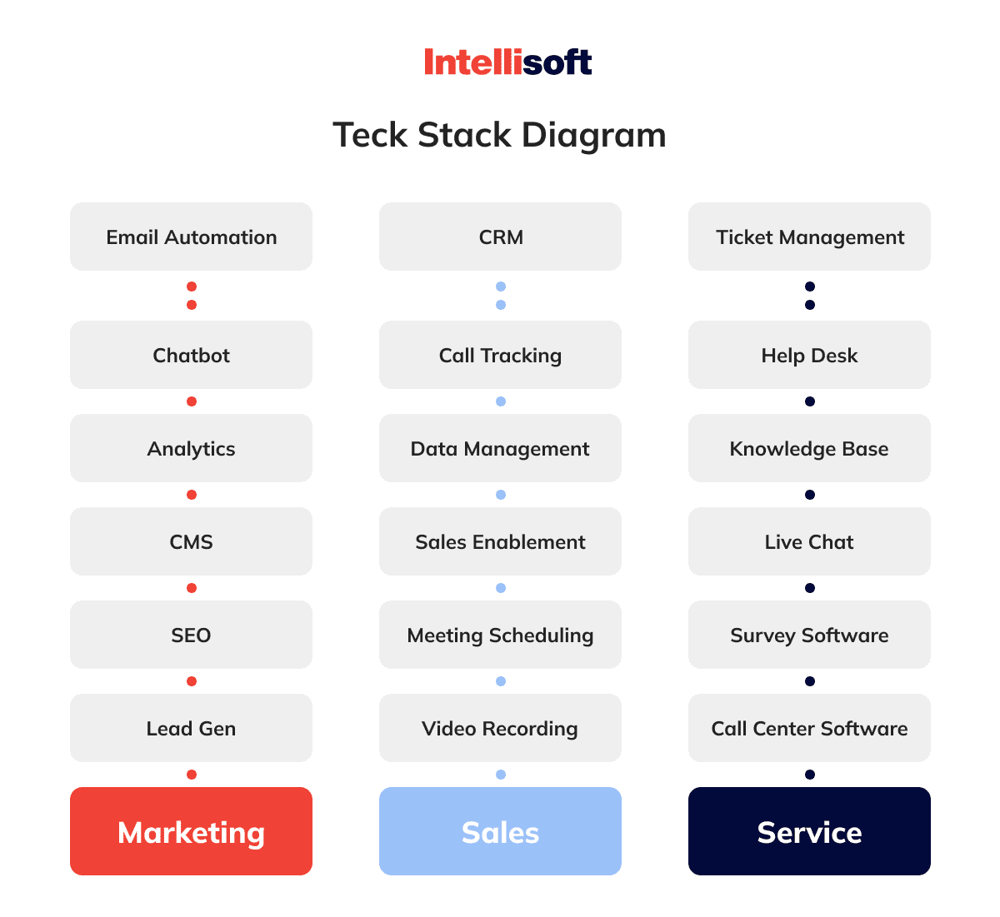
Technology Stack
Components of the Technology Stack:
Programming Languages: Python for data crawling and analysis; JavaScript for dashboard development.
Frameworks: Flask for web framework; D3.js for data visualization.
Tools: Elasticsearch for data storage and search; Docker for containerization.
Role of Each Component: A concise description of each technology’s role will be provided alongside relevant logos to enhance visual appeal.

Slide 8
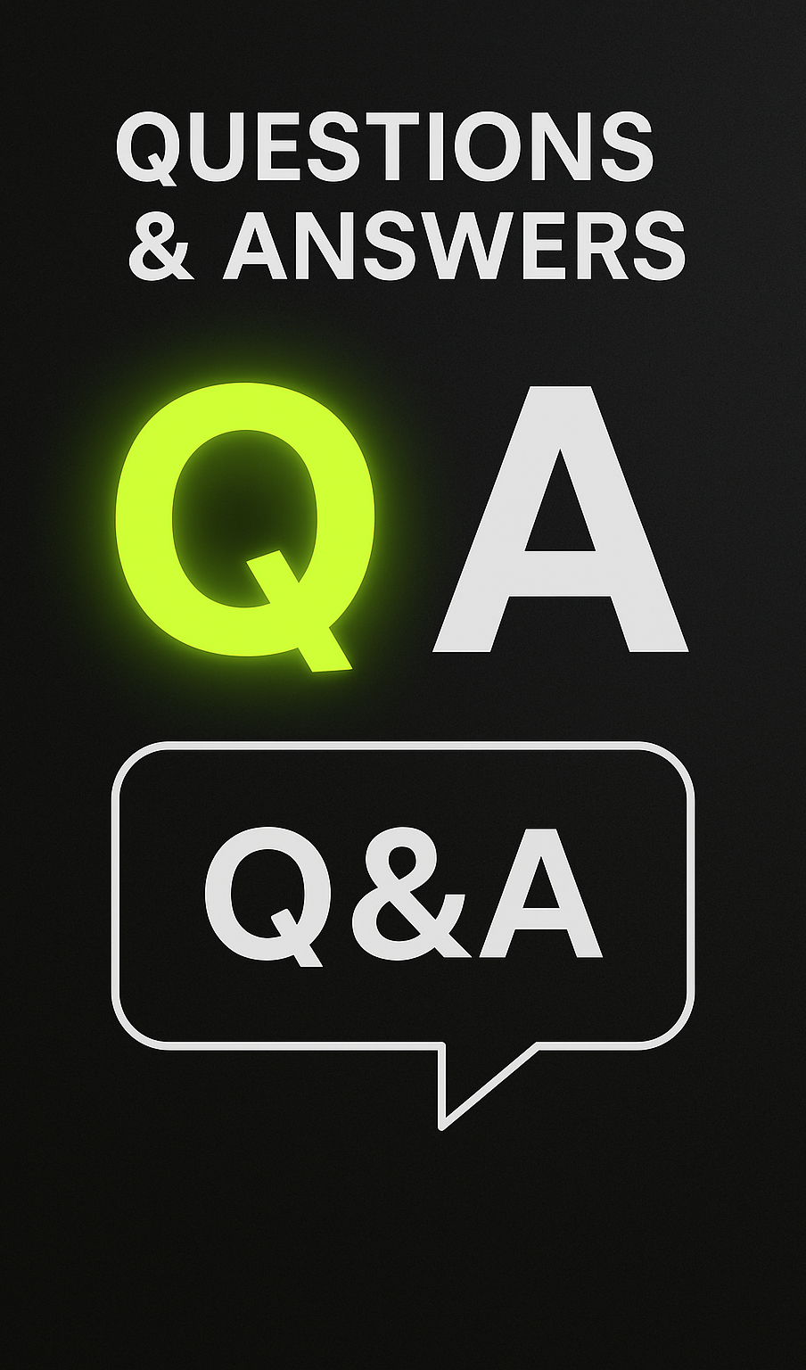
Thank You and Q&A
Parvezshaik011@gmail.com
👥 Team: Dark Trace Unit

